Slide 1
Intriguing properties of neural networks
Hepsiba Komati supervisor : Benedikt

Slide 2
Presentation Overview
Summary of paper
  Terminology
  Adversarial attack
  Semantic information in units
Strengths
Weaknesses
Discussion

Slide 3
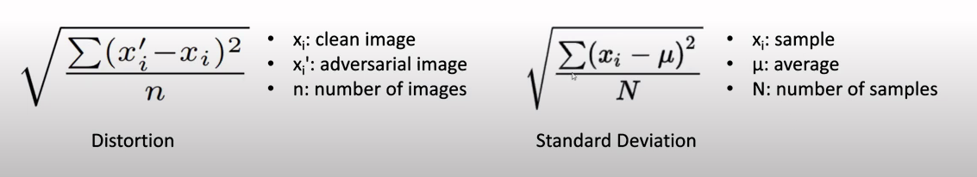
Summary: Terminology
Unit: neuron
The standard term in literature
Distortion: adversarial perturbation
Standard deviation of pixels

Slide 4
Summary
Adversarial Attack:
  Assumption: Classifiers are robust
  Finding: adversarial examples exist
Semantic information in units:
  Assumption: units separate features
  Finding: maybe not

Slide 5
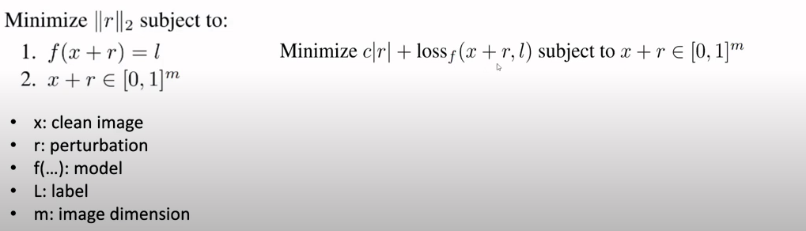
Adversarial Attack
L-BFGS
White-box, slow, targeted

Slide 6
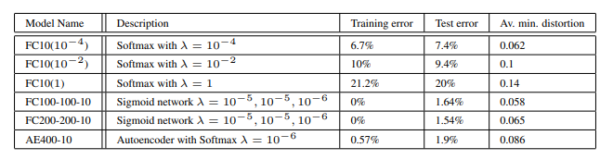
Adversarial Attack Table 1
Adversarial examples exist
  100% fooling rate on MNIST images
Larger lambda = larger perturbations
Larger lambda = less accurate

Slide 7
Summary
Assumption: Classifiers are robust
Finding: adversarial examples exist
Questions:
Transfer to different model?

Slide 8
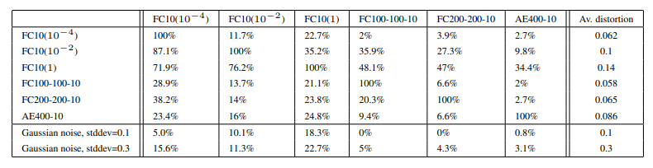
Adversarial Attack Table 2
Adversarial images on same model = 100%
Attacks transfer to different models*
*Sometimes

Slide 9
Summary
Assumption: Classifiers are robust
Finding: adversarial examples exist
Questions:
Transfer to different model?
  Sometimes
Transfer to different model, no training overlap?

Slide 10
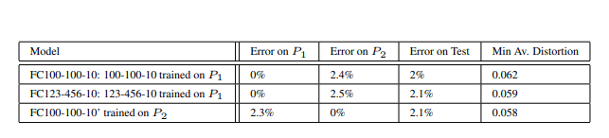
Adversarial Attack Table 3
Trained on different datasets
Good network generalization
Similar average perturbation

Slide 11
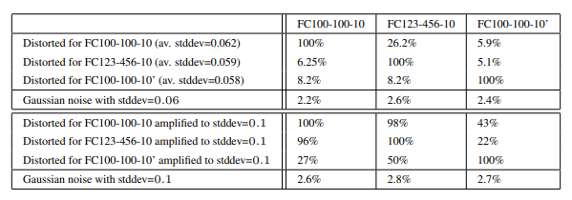
Adversarial Attack Table 4
different model, different dataset
Attacks transfer to different models with no training overlap
*Sometimes

Slide 12
Summary
Assumption: Classifiers are robust
Finding: adversarial examples exist
Questions:
Transfer to different model?
  Sometimes
Transfer to different model, no training overlap?
  Sometimes
How can these attack exist?

Slide 13

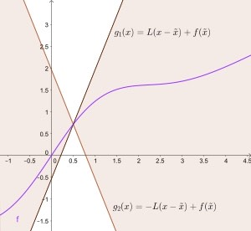

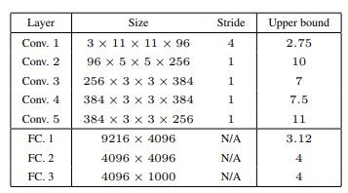
Adversarial Attack Mathematical Basis
Spectral Analysis of Unstability:
Lipschitz constant: largest slope
Notes:
Instabilities early
Upper bound doesn’t Proven existence.
Reduced upper bound limits attacks.

Slide 14
Summary
Adversarial Attack
Semantic information in units:
Assumption: Units separate features
Finding: maybe not

Slide 15
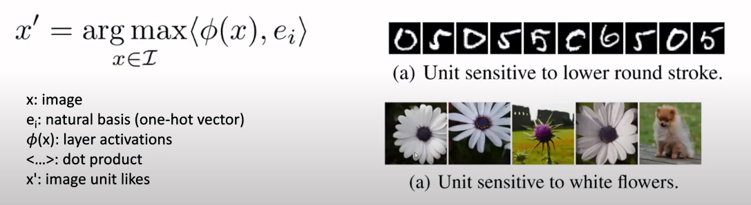
Unit Analysis Method
Analyse hidden unit by collecting images unit likes
Appears to work less

Slide 16
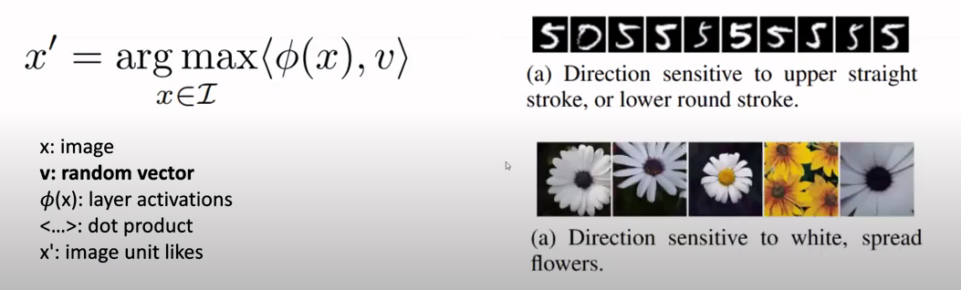
Unit Analysis Method
Replace ei With a random vector
Also appears to work well

Slide 17
Final Summary
Adversarial attack question robustness
Transferrable to different models
Transferrable to different models with no dataset overlap
Math basic for attacks existing
Semantic information is spread amount units
Analysing individual units is difficult

Slide 18
Strengths
Good explanations for high level understanding
  Relating to core understandings of DNN
Clear quantitative results
Wide-spread implications
  Transferability
Useful mathematical analysis
  Potential to reduce attack effectiveness

Slide 19
Weaknesses
Proposed properties seem to be disjoint
Random combination of units is not well explained
Weak experiments supporting second property
Adversarial input generation is not detailed
Results from adversarial training are insignificant
Little evidence for “extremely low probability” of adversarial inputs

Slide 20
THANK YOU

